Slide 1
Solving Marketing Complexity
(for fun and profit)

Slide 2
Marketers, We Have a Problem!

Slide 3
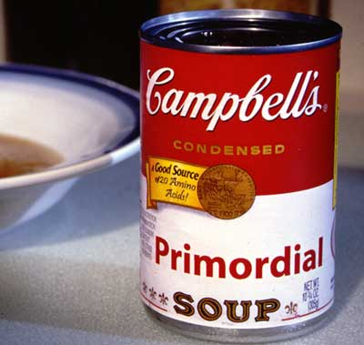
THIS is the problem

Slide 4
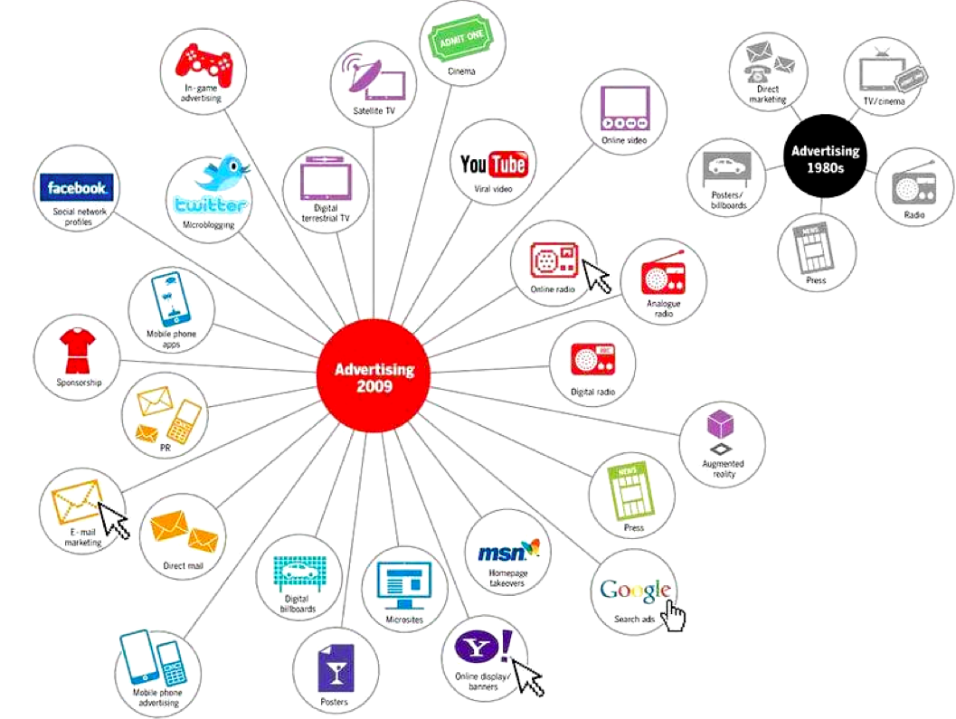
Actually THIS is the problem (too many channels!)

Slide 5
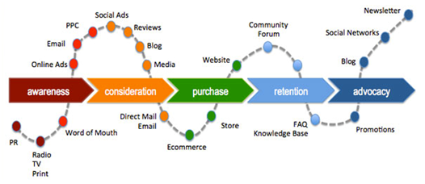
Actually THIS is the problem (too many conversion paths!)

Slide 6
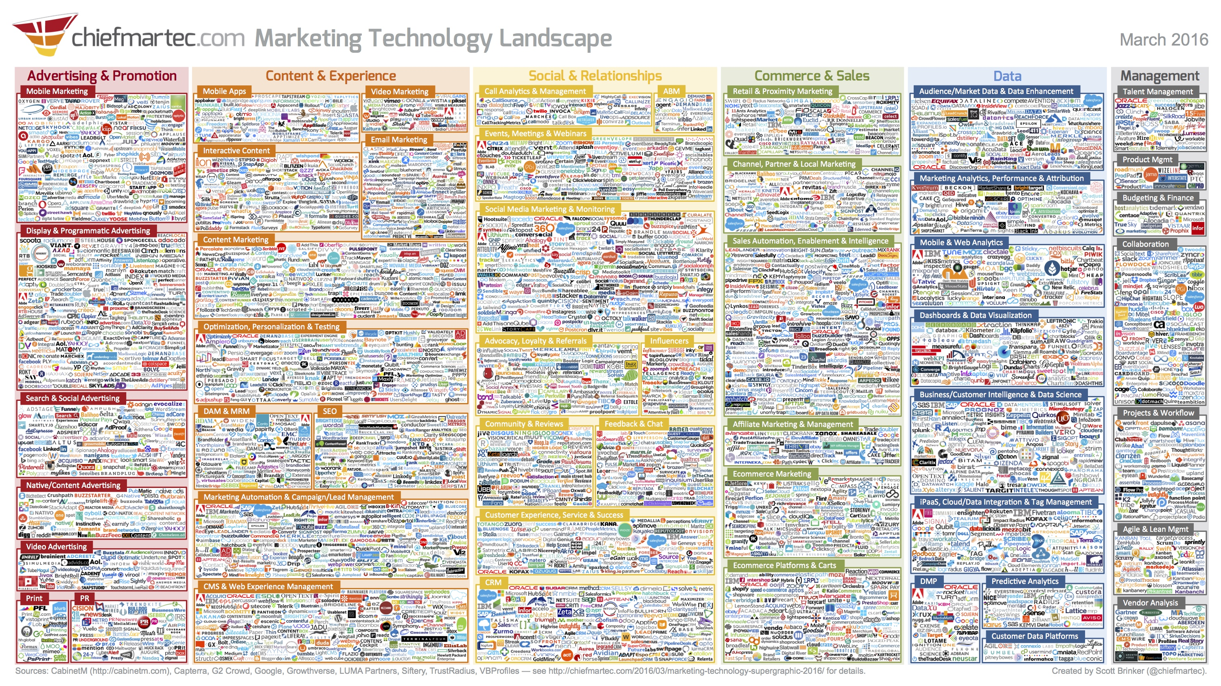
Actually THIS is the problem (too many tech solutions)

Slide 7
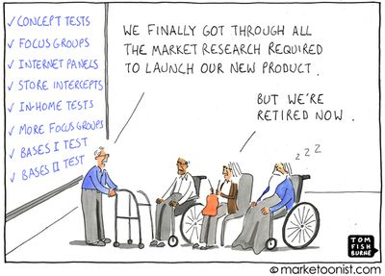
Actually THIS is the problem (analysis paralysis)

Slide 8
Actually THIS is the problem (too many devices)

Slide 9
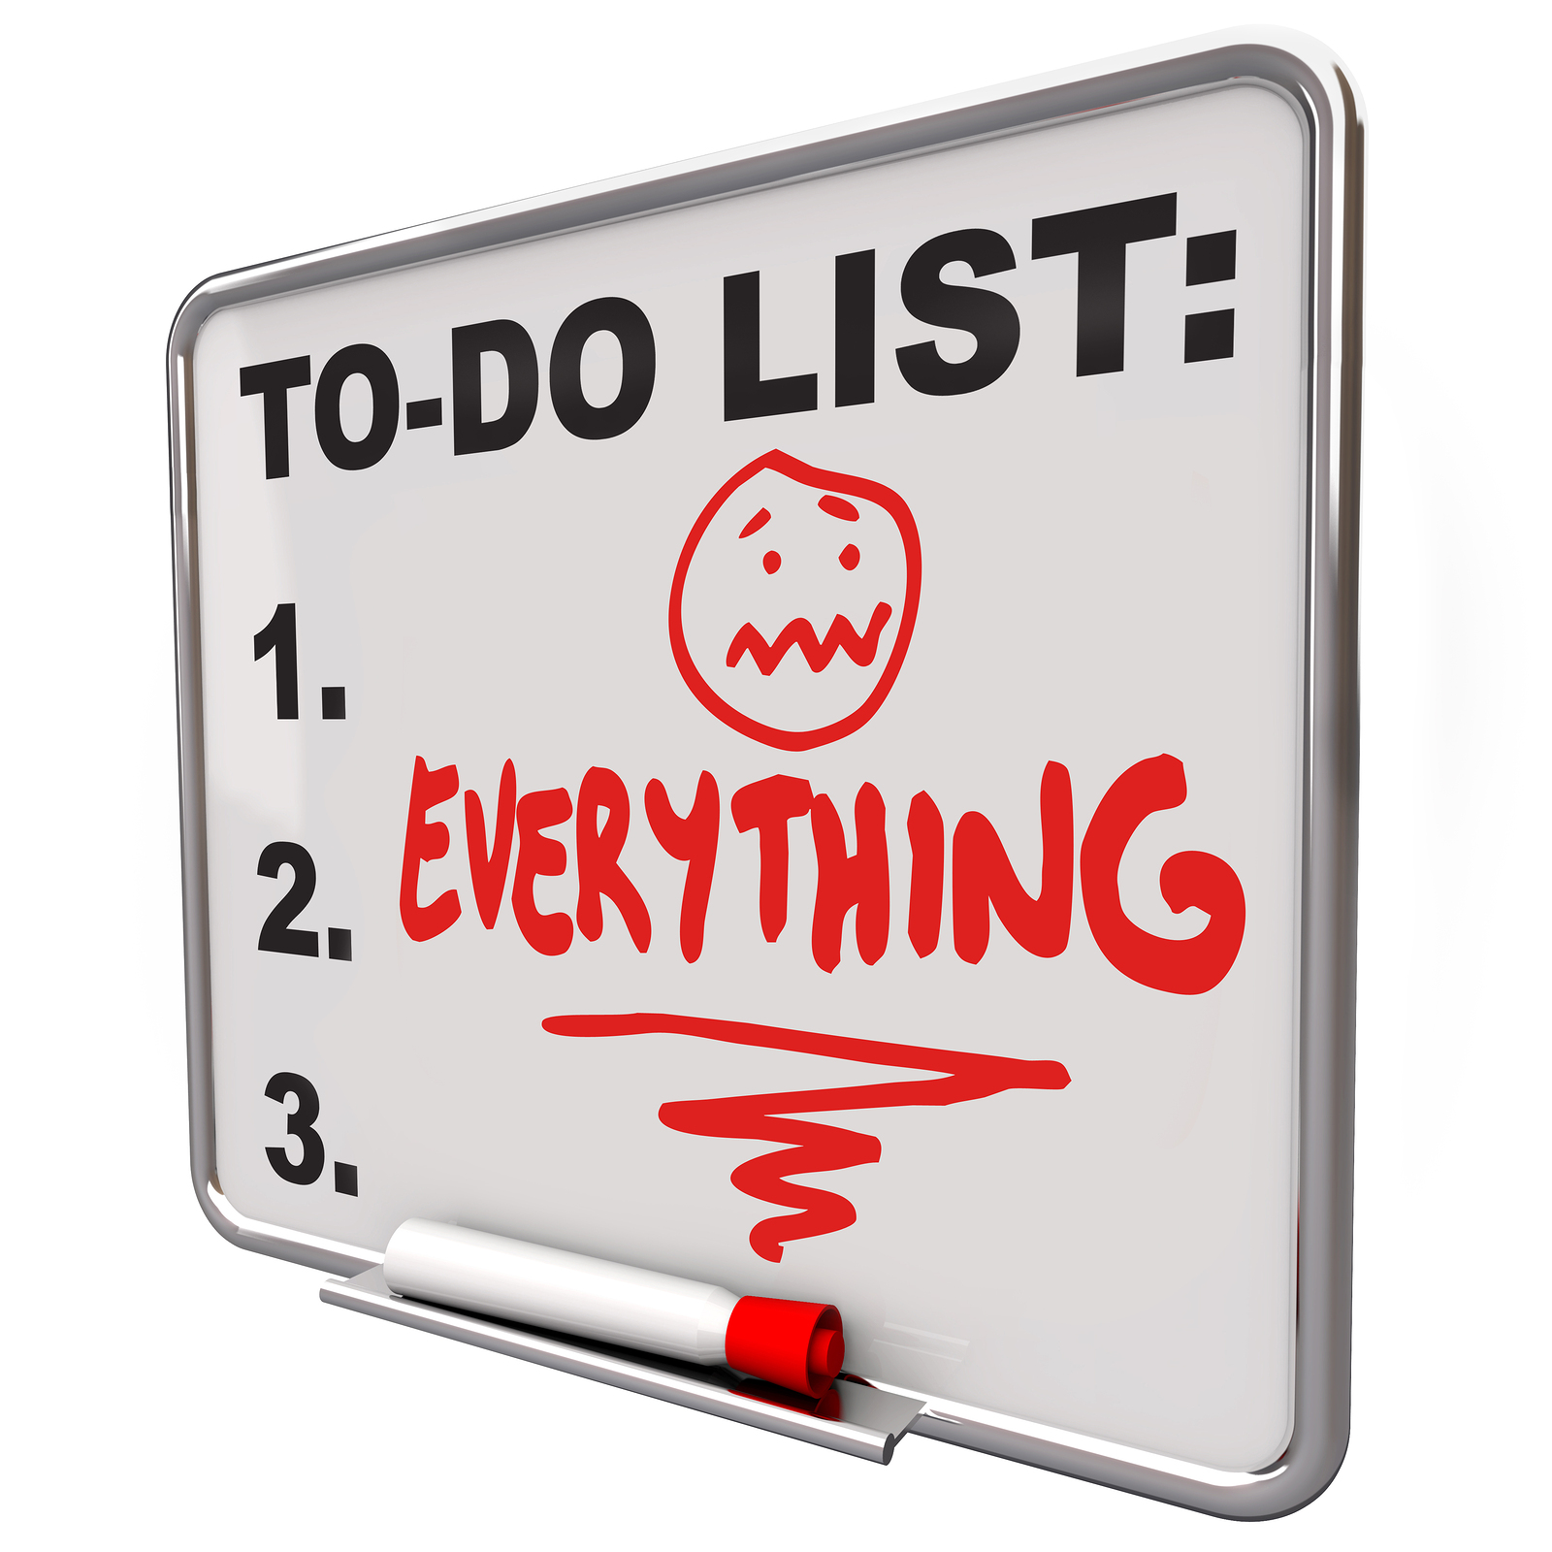
Actually IT’S ALL A PROBLEM

Slide 10
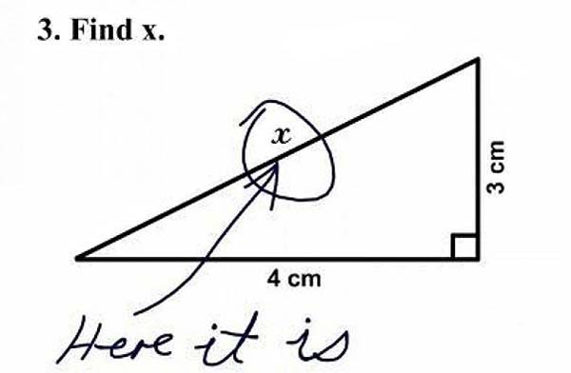
Problem . . . Meet Solution
The Problem:
Optimizing bottom-of-the-funnel media is great, but it’s only part of the story
Complexity is increasing faster than in-house resources
Our Solution:
More than 20 F/T hires outside of media buying
Investment of more than $4 MILLION DOLLARS
Partnerships with more than 20 technology vendors

Slide 11
Challenges to Sustained Growth
When working in silos, and focusing on single-channel returns, over time diminishing returns will be experienced, and programs will start to plateau
GROWTH
MEDIA
(PAID SEARCH)
TIME

Slide 12
Customer Focus and Coordination = Sustained Growth
Starting with the Customer, and coordinating that understanding across channels, the user experience, and devices, sustained growth can be achieved
DEEP UNDERSTANDING OF THE CUSTOMER
CROSS-DEVICE STRATEGY
GROWTH
INSIGHTFUL ANALYTICS
CONVERSION RATE OPTIMIATION
MEDIA
(PAID SEARCH)
TIME

Slide 13
The 3Q Customer Accountability Model
Structure & Alignment
Customer Model
Growth Drivers
Proprietary model leverages research & customer data to get a deeper, richer view of the customer across the entire customer lifecycle.
The foundation for marketing effectiveness. Uses qualitative and quantitative data to identify the greatest areas of opportunity across the entire marketing organization
Single customer view across the marketing organization
Customer Engagement Execution
Driven by customer data model / segmentation / stage
Data Management Platform
Customer driven taxonomy and rules by segment / stage
Data Warehouse
Clean accurate view of customer engagement driving insights
Measurement and Refinement
Notes:
We are bringing it all together into a single product/offering. This will represent the sum of what we do for clients. This is how it works/flows together.

Slide 14
Introducing The 3Q Customer Accountability Model
Awareness
Research
Evaluate
Transact
Enjoy
Advocate
Bond
Repeat
CUSTOMER LIFECYCLE
Actions | Outcomes | Motivations | Emotions | Questions | Barriers
MARKETING CHANNELS
MARKETING
UX / CRO / CONTENT
ANALYTICS
AUDIENCE | SIZE | % | LTV | TOP NEEDS | DEMO SKEWS | USAGE BEHAVIOR
Millennial | 16,250 | 25% | $875 | Aspirational | Male, 18-24 | Mobile, mobile app
Middle Aged | 15,000 | 11% | $850 | Better prices | Female, 44-60 | Weekly browsing and item saving
Top Client | 72,500 | 10% | $570 | More inventory | Female, 34-54 | Responds to emails, push notifications
One-time buyer | 45,000 | 7% | $450 | More inventory | Female, 25-35 | Unsubscribes, does not self navigate back
KEY SEGMENTS

Slide 15
3Q Customer Accountability Model
Awareness
Evaluate
Transact
Bond
Actions Outcomes Motivations Questions Barriers Emotional connection
CUSTOMER LIFECYCLE
PAID SOCIAL / MOBILE
MARKETING
ADS / CRO
REPORTING / ANALYSIS
AUDIENCE | SIZE | % | LTV | TOP NEEDS | DEMO SKEWS | USAGE BEHAVIOR
Millennial | 16,250 | 25% | $875 | Aspirational | Male, 18-24 | Mobile, mobile app
KEY SEGMENTS

Slide 16
Lifecycle - Customer Perspective
Awareness
Evaluate
Transact
Bond
ACTIONS
OUTCOMES
MOTIVATIONS
QUESTIONS
BARRIERS
EMOTIONAL CONNECTION

Slide 17
Lifecycle – Business Perspective
Awareness
Evaluate
Transact
Bond
DESIRED ACTIONS
TOUCHPOINTS
LEVERS
TESTS
TOOLS
GAPS

Slide 18
Lifecycle – Marketing Perspective
Awareness
Evaluate
Transact
Bond
GOALS
KPIS
DATA SOURCES
MARKETING CHANNELS
MESSAGING
USER EXPERIENCE

Slide 19
When Fully Implemented You Have Actionable Visibility Into . . .
What are the stages of the customer journey?
How do different customer segments act across different segments?
What channels do I need at each stage for each segment?
What messaging do I need at each stage, on each channel, for each segment?
What devices do my customers use?
What conversion funnel(s) do I need to create?

Slide 20
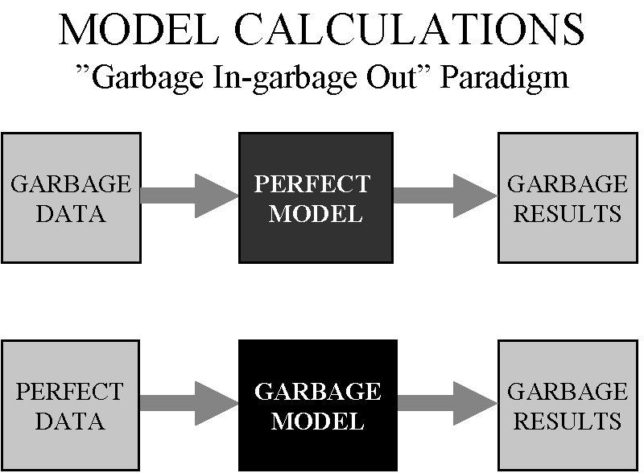
But Wait! How Do I Measure All of This Stuff?

Slide 21
A Framework for Decision Sciences
Measurement | Data Management | Performance | Insights | Optimization
We’ve focused our core existing and new deliverables, into a framework that solves for end-to-end coverage of all of our clients’ Analytics needs

Slide 22
Understanding the Past & the Future; Driving Action
Measurement | Data Management | Performance | Insights | Optimization
Descriptive | Predictive | Prescriptive
We’ll deliver through three key points of view, to address why something happened, what else will happen and what we should do about it

Slide 23
Who, What & Where!
Measurement | Data Management | Performance | Insights | Optimization
Descriptive | Predictive | Prescriptive
Channels | Audiences | Content
With greater insight so that we can better understand and deliver to the right audiences, with the right content, in the right channels

Slide 24
Technology Enablement
Tag Management / Customer Data / Data Collection
Analytics
Attribution
Display
Search
Social
Mobile
Direct Mail
CRM
Call Center
Data Management Platform
1st, 2nd and 3rd Party Data
Offline Data
Segmentation
Look-a-Likes
Cross-Device
SEM
Social
Display
Mobile
Email
Direct Mail
CRM
Call Center
Site, Display, Text, Offer and Experience Testing
Data Warehouse
Reporting and Campaign Insight
Cross-Device/Screen Insight
Data Visualization
Notes:
Viewability, cross-device graphing, offline data onboarding

Slide 25
Analytics Framework and Deliverables
1. Measurement
2. Data Management
3. Performance
Measurement Planning
Tracking, Tagging and Pixel Strategy
Tag / Pixel Creation
Mobile Analytics Strategy
Mobile Analytics Implementation
Cross Device Tracking/Measurement
CRO Measurement
Campaign Data Warehousing
Tag Management
Campaign Attribution
Data Management Platform
Customer Segmentation Development
Customer Data (DB)
Media Performance Projections
Media Budget Scenario Planning
Predictive Modeling
5. Optimization
4. Insights
Learning/Testing Agenda
CRO Planning and Insights
Personalization Data Strategy
Retargeting Strategy
Weekly Reporting
Monthly Reporting
Qtly/Annual Business Review
Automated Reporting
Campaign Attribution Reporting
Data Audit and Validation
Consumer Path & Fallout Analysis
Site/UX and Conversion Audit
SEO Analytics Deep Dive
LTV Setup and Framework
CRM Analytics
Retail Analytics
Media Brand Lift Studies
Site Satisfaction Studies
Product Satisfaction Studies
Opportunity Discovery
Social Listening
Social Audience Segmentation
Text Based Consumer Intent
Cross Device Behavioral Analysis
Channel Incrementality
Executive Dashboard / Scorecards
Data Visualization
Performance Benchmarking

Slide 26
Too Much, Too Soon?

Slide 27
A Stepping Stones Approach
Optimize Media Channels
Optimize Analytics and CRO
Strategic Growth Assessment
Implement CAM

Slide 28
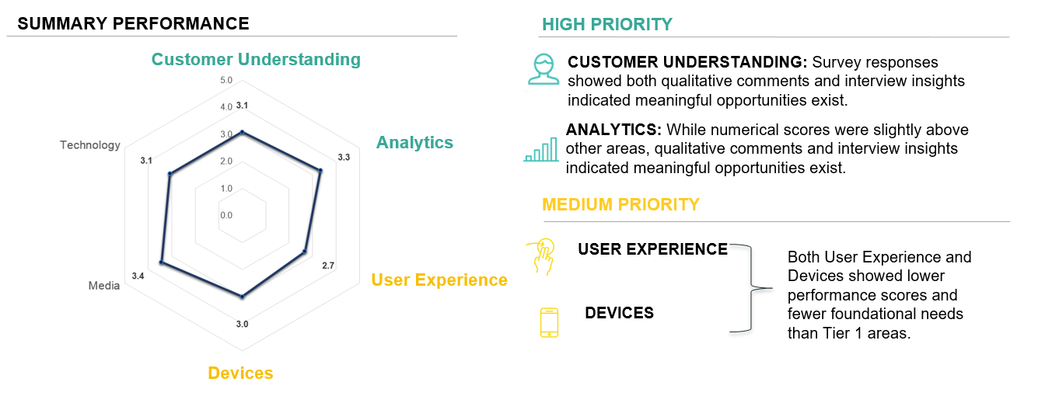
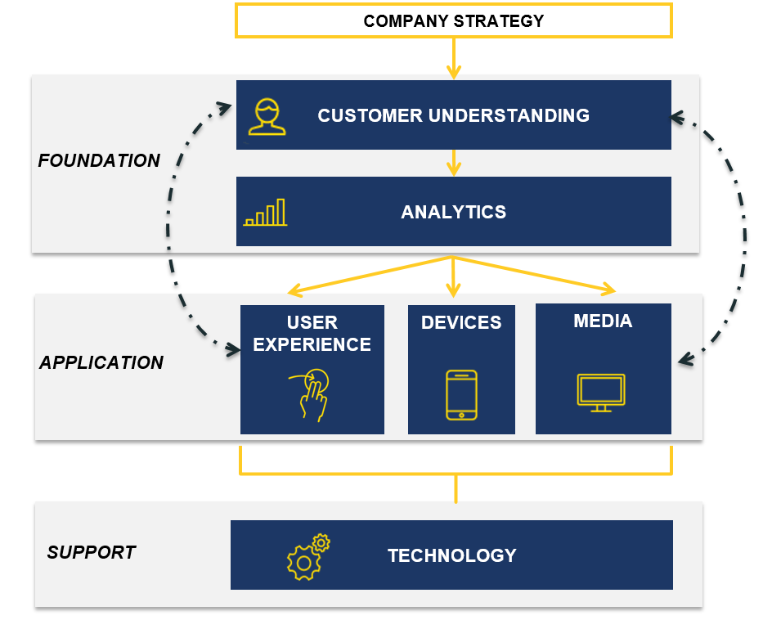
Section 1 | Overview
3Q Strategy Assessment - Approach
A fact-based approach relying on primary and secondary research was used to derive prioritized recommendations to improve performance
INPUT
ANALYSIS
OUTPUT
PRIMARY AND SECONDARY RESEARCH
GROWTH ASSESSMENT FRAMEWORK
FINDINGS AND INSIGHTS
Qualitative Interviews and Discussions
Company Marketing Professionals Executive Team Subject matter experts 3Q Digital knowledge base
Documentation Reviewed
Executive self-assessment 3Q Team assessment Executive Interviews | Site material Leading practice documentation Secondary research
Interview Guides
Interview Notes
RECOMMENDATIONS
GROWTH DRIVER SNAPSHOT AND SUMMARY
PRIORITIZED RECOMMENDATIONS
Note: Projects stemming from the recommendations might have started throughout the duration of the assessment

Slide 29
Section 1 | Overview
The Six Marketing Growth Drivers
A framework of six Growth Drivers is used to evaluate marketing effectiveness.
FRAMEWORK
MARKETING ASSESSMENT FRAMEWORK
DESCRIPTION
A clear understanding of what customers are trying to accomplish with the product or service.
Using analytics to explain the impact of marketing actions on customer engagement.
Dark arrows indicate the iterative nature of the work, cycling measurement and customer findings through user experience, devices and channels, before cycling around again.
Insights from customer understanding and analytics should then flow into user experience, devices, and media strategy.
Sufficient technology must exist to support scale in all other areas.

Slide 30
Section 2 | Executive Summary
Prioritization
Urgency / Impact criteria are applied to each recommendation. Results are plotted in the Prioritization Matrix. Short-term focus should concentrate on Tier 1 recommendations where we see higher-impact, higher-urgency recommendations.
OPPORTUNITY PRIORITIZATION MATRIX
RECOMMENDATIONS BY GROWTH DRIVER
High
Med
Low
 | Low | Med | High
CUSTOMER UNDERSTANDING
TIER 1
ANALYTICS
USER EXPERIENCE
1**
1**
TIER 2
1
Buying process research
Pre-purchase journey development
Role of competitors on buyers
Emotional connection research
Convertro implementation**
Incorporate offline conversions
Channel role analysis
Scenario ROI modeling
GTM audit
Begin CRO testing**
Gain customer insight
Incorporate Sales feedback into new tests
Move testing up-funnel
3
2
2
2
2
1
TIER 3
3
3
4
2
1
3
4
4
3
4
DEVICES
MEDIA
TECHNOLOGY
4
5
Convertro for mobile insight
Research mobile investment by similar companies
Incorporate Sales knowledge
Mobile CRO and new UX development
Media mix optimization
Phone tracking
Native/content strategy
Direct mail-social lift test
Technology solutions are embedded within other recommendations.
Urgency
Impact
Impact
**in progress

Slide 31
3Q Digital Services – A New Way to Think About our Offering
We are the RIGHT mix of strategic consulting, agile execution, technology, and analytics, supported by a proprietary Customer Accountability Model built to eliminate complexity and drive deeper customer engagement and growth.
Consulting
Customer Accountability
Strategic Growth Drivers
Operational Impact
Execution
Media
Mobile
User Experience
Technology
Customer Data & Tag Management
Data Management Platform
Automation and Personalization
Analytics
Performance & Optimization
Insights
Measurement
Notes:
We have 3 proprietary offerings and 8+ years of executing for the worlds most innovative and high growth companies in the world. Together we have some real differentiators. Together we are uniquely qualified to help brands drive growth and customer engagement.

Slide 32
Putting it All Together
Media Buying
Strategy & Insight
Growth Services
2WQ

